Slide 1





職
事
場
故

Slide 2

1.目標
Notes:
https://pixabay.com/videos/dog-santa-claus-christmas-reading-138974/

Slide 3

2.阻礙
Notes:
https://www.istockphoto.com/en/video/black-hole-color-03-gm1362670187-434505440

Slide 4
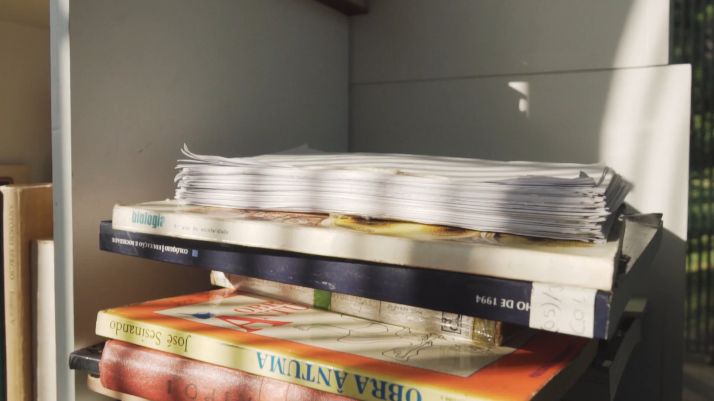
3.努力
Notes:
https://pixabay.com/videos/books-panning-book-fictional-novel-27444/

Slide 5

4.結果
Notes:
https://pixabay.com/videos/man-suit-formal-confusion-decision-80702/

Slide 6

5.意外
Notes:
https://pixabay.com/videos/idea-light-bulb-innovation-think-64865/

Slide 7

6.轉彎
Notes:
https://pixabay.com/videos/board-light-bulb-chalk-success-18400/

Slide 8

7.結局
Notes:
https://pixabay.com/videos/boy-reading-book-learning-child-57753/

Slide 9
感
謝
聽
聆

